Slide 1
Assignment 3 Named Entity Recognition on MSRA corpus
陳臆玄 2022/04/28

Slide 2
Outline
Assignment 3 Introduction
Sequence Labeling Problem
Use BERT BiLSTM CRF Model for Named Entity Recognition
Submission
Source Code
A Short Report
Grading Policy

Slide 3
Assignment 3 Introduction

Slide 4
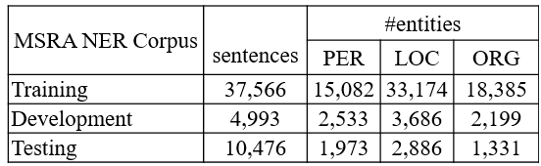
Assignments #3 – Information Extraction
Sequence labeling task with CRF packages and your model:
MSRA Name Entity Recognition (NER) Corpus

Slide 5
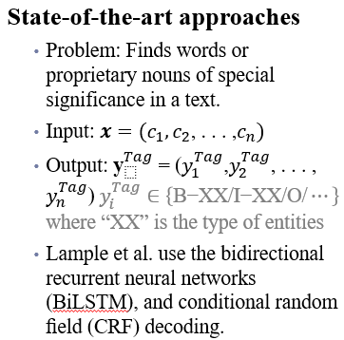
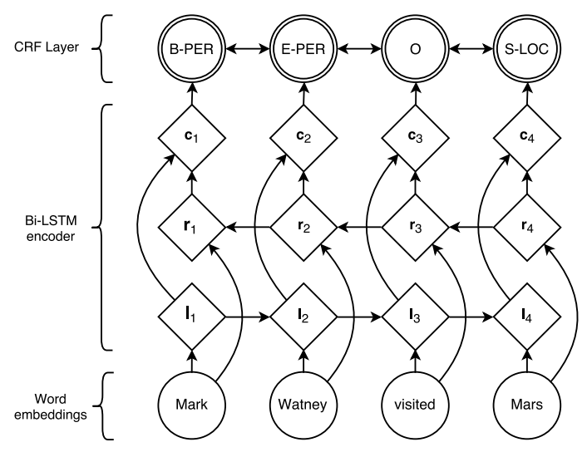
Sequence Labeling Problem [2016 ACL]
•Related research:
•Neural architectures for named entity recognition. (Lample et al., 2016 ACL)
Figure : Neural Architectures for Named Entity Recognition.

Slide 6
Sequence Labeling Problem (Background)
IOB or IOBES scheme
State-of-the-art named entity taggers follow the sequence labeling framework using IOB or IOBES scheme.
Example of IOB scheme:
Thus , indomethacin by inhibition of prostaglandin synthesis may diminish
O O B-Chemical O O O B-Chemicl I-Chemicl O O
Label
Example of IOBES scheme:
Thus , indomethacin by inhibition of prostaglandin synthesis may diminish
O O S-Chemical O O O B-Chemicl E-Chemicl O O
Label
Under Line = Entity
(B-begin，I-inside，O-outside)
(B-begin，I-inside，O-outside，E-end，S-single)
Indomethacin: 吲哚美辛
Prostaglandin synthesis: 前列腺素合成
Notes:
Indomethacin）是一種非類固醇消炎止痛藥（NSAID）
prostaglandin synthesis: 前列腺素合成

Slide 7
Use BERT BiLSTM CRF Model for Named Entity Recognition

Slide 8
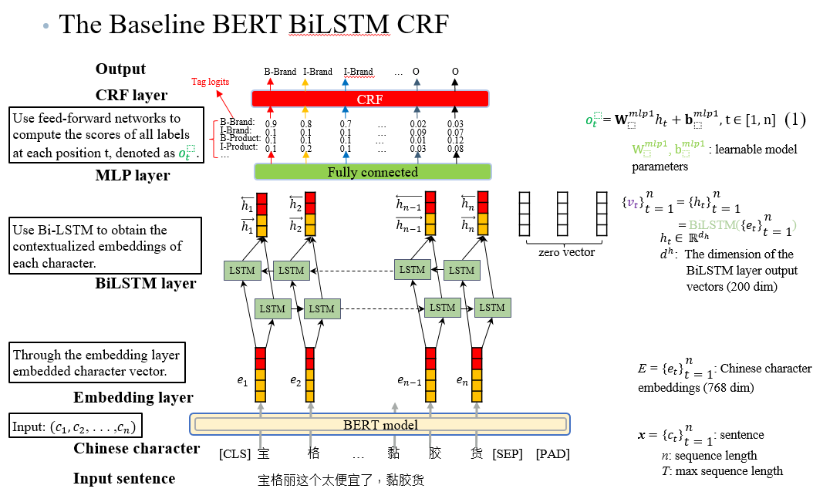
BERT BiLSTM CRF Model (code download)
Notes:
Embedding layer嵌入字符向量。使用 Bi-LSTM 獲取每個字符的上下文嵌入，最終進入CRF層進行解碼，計算最優的標註序列。

Slide 9
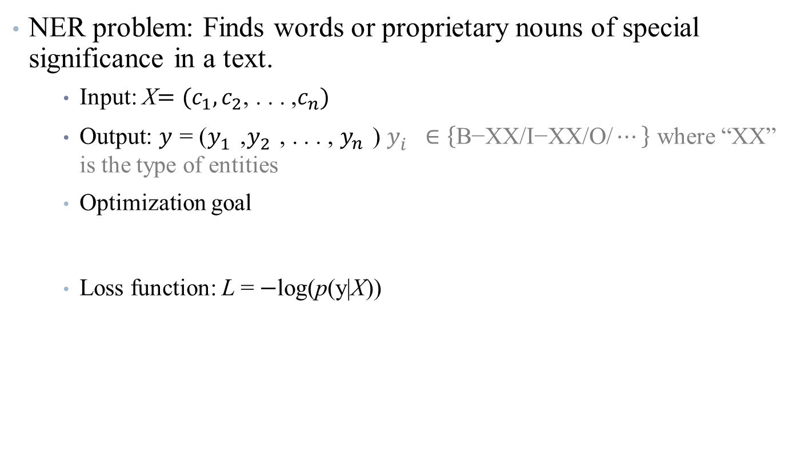
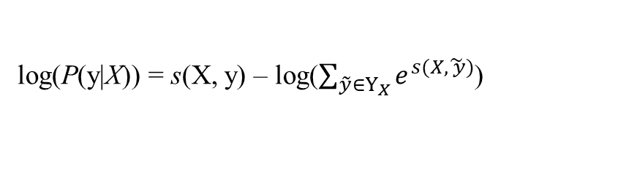
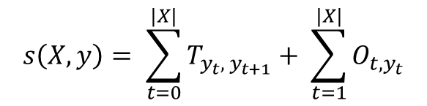
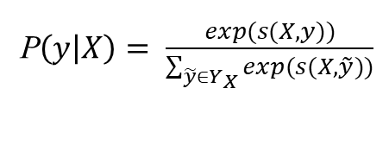
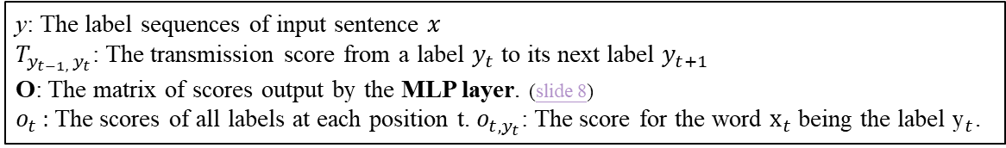
Problem Definition
(2) CRF log likelihood
(3) Scoring function
(4) CRF log likelihood
Notes:
NER 問題：在文本中查找具有特殊意義的單詞或專有名詞。

Slide 10
Sample Code: Install Step
Install step
Install PyCharm IDE/Install Anaconda
Install Python package
export PATH="/home/<user>/anaconda3/bin:$PATH"
source /home/<user>/anaconda3/etc/profile.d/conda.sh
conda activate wimuta_hw3_ner_env
conda env list
conda create --name wimuta_hw3_ner_env python=3.7

Slide 11
Sample Code: Install Step (cont.)
conda activate wimuta_hw3_ner_env
pip install tensorflow==2.3.0-rc1
pip install sklearn
pip install pandas
pip install IPython
pip install keras
pip install tqdm
pip install xlrd
pip install openpyxl
conda install -c anaconda ipython
pip install matplotlib
pip install tensorflow_hub
pip install transformers==4.4.2
pip install gin-config
pip install tensorflow_addons

Slide 12
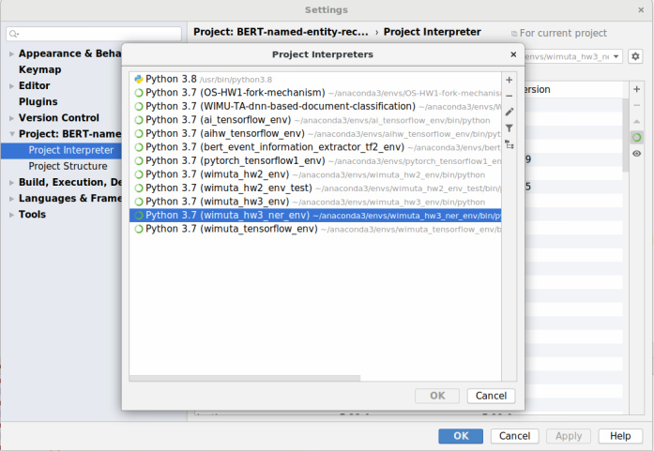
Sample Code: Install Step (cont.)
Install Python package: tensorflow/models, patch version of bert-for-tf2
Click button

Slide 13
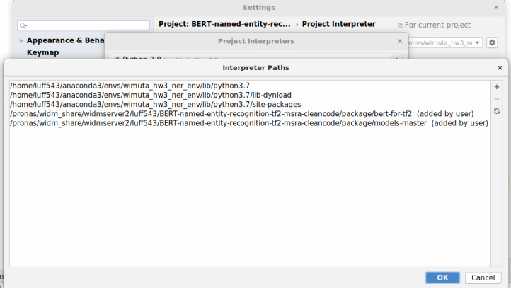
Sample Code: Install Step (cont.)
Add models path

Slide 14
Sample Code: system.config
system.config (data.py)
### use # to comment out the configure item
################ Status ################
mode=train
# string: train/evaluate_test
################ Datasets(Input/Output) ################
datasets_fold=data/example_datasets_msra
train_file=train.txt
dev_file=dev.txt
delimiter=b
# string: (t: "\t";"table")|(b: "backspace";" ")|(other, e.g., '|||', ...)
vocabs_dir=data/example_datasets_msra/vocabs
log_dir=data/example_datasets_msra/logs
checkpoints_dir=checkpoints/datasets_bert-bilsm
################ Labeling Scheme ################
label_scheme=BIO
# string: BIO/BIESO
label_level=2
# int, 1:BIO/BIESO; 2:BIO/BIESO + suffix
# max to 2
hyphen=-
# string: -|_, for connecting the prefix and suffix: `B_PERSON', `I_LOC'
suffix=[ORG,PERSON,LOC]
# unnecessary if label_level=1
measuring_metrics=[precision,recall,f1]
# string: accuracy|precision|recall|f1
# f1 is compulsory
################ Model Configuration ################
embedding_dim=768
# int, must be consistent with `token_emb_dir' file
hidden_dim=200
max_sequence_length=128
# int, cautions! set as a LARGE number as possible,
# this will be kept during training and inferring, text having length larger than this will be truncated.
CUDA_VISIBLE_DEVICES=0
# coincides with tf.CUDA_VISIBLE_DEVICES
seed=42
################ Training Settings ###
epoch=30
batch_size=6
dropout=0.1
learning_rate=0.00002
optimizer=AdamW
# string: AdamW/SGD/Adagrad/AdaDelta/RMSprop/Adam
checkpoints_max_to_keep=30
print_per_batch=20
is_early_stop=False
patient=10
# unnecessary if is_early_stop=False
checkpoint_name=model

Slide 15
Sample Code
Practice step
BertDataManager class: Loading data and BERT input encoding (data.py)
class BertDataManager:
"""
Bert的數據管理器
"""
def __init__(self, configs, logger):
hub_url = "https://tfhub.dev/tensorflow/bert_zh_L-12_H-768_A-12/2"
l_bert = hub.KerasLayer(hub_url, trainable=True)
vocab_file = l_bert.resolved_object.vocab_file.asset_path.numpy()
do_lower_case = l_bert.resolved_object.do_lower_case.numpy()
FullTokenizer = bert.bert_tokenization.FullTokenizer
self.tokenizer = FullTokenizer(vocab_file, do_lower_case)
self.max_token_number = len(self.tokenizer.vocab)
self.max_label_number = len(self.label2id)
def load_labels(self):
def build_labels(self, train_path):
Load pre-trained BERT encoder from TensorFlow Hub.
Load wordPiece tokenizer.
Load vocabulary size, number of labels

Slide 16
Sample Code
BertDataManager class: Encode string feature to BERT input format (data.py)
class BertDataManager:
…
def prepare(self, df):
X = [], y = [], att_mask = [], segment = []
return np.array(X), np.array(y), np.array(att_mask), np.array(segment)
def get_training_set(self, train_val_ratio=0.9):
"""
獲取訓練數據集、驗證集
:param train_val_ratio:
:return:
"""
df_train = read_csv(self.train_file, names=['token', 'label’],
delimiter=self.configs.delimiter)
X, y, att_mask, segment = self.prepare(df_train)
# shuffle the samples
…
return X_train, y_train, att_mask_train, X_val, y_val, att_mask_val,
segment, segment_val
def next_batch(self, X, y, att_mask, segment, start_index):
return X_batch, y_batch, att_mask_batch, segment_batch
Load X (features) and y (labels)

Slide 17
Sample Code (cont.)
Create customizing models by TensorFlow 2 Subclassing API (bert_model.py)
from tensorflow_addons.text.crf import crf_log_likelihood
import tensorflow_hub as hub
from tensorflow.keras.models import Model
import bert # patch version of bert-for-tf2
class BiLSTM_CRFModel(tf.keras.Model):
def __init__(self, configs, vocab_size, num_classes, **kwargs):
super().__init__(**kwargs) # 處理標準引數，例如名稱name
max_seq_length = configs.max_sequence_length
input_word_ids = tf.keras.layers.Input(shape=(max_seq_length,), dtype=tf.int32,
name="input_word_ids")
input_mask = tf.keras.layers.Input(shape=(max_seq_length,), dtype=tf.int32,
name="input_mask")
segment_ids = tf.keras.layers.Input(shape=(max_seq_length,), dtype=tf.int32,
name="segment_ids")
hub_url = "https://tfhub.dev/tensorflow/bert_zh_L-12_H-768_A-12/2"
self.l_bert = hub.KerasLayer(hub_url, trainable=True)
pooled_output, sequence_output = self.l_bert([input_word_ids, input_mask, segment_ids])
self.model = Model(inputs=[input_word_ids, input_mask, segment_ids],
outputs=[pooled_output, sequence_output])
self.model.build(input_shape=[(None, max_seq_length), (None, max_seq_length), (None,
max_seq_length)])

Slide 18
Sample Code (cont.)
Create BERT BiLSTM CRF model by TensorFlow 2 API (bert_model.py)
class BiLSTM_CRFModel(tf.keras.Model):
def __init__(self, configs, vocab_size, num_classes, **kwargs):
…
self.hidden_dim = configs.hidden_dim
self.dropout_rate = configs.dropout
self.dropout = tf.keras.layers.Dropout(self.dropout_rate)
self.bilstm = tf.keras.layers.Bidirectional(tf.keras.layers.LSTM(self.hidden_dim, return_sequences=True))
self.dense = tf.keras.layers.Dense(num_classes)
self.transition_params = tf.Variable(tf.random.uniform(shape=(num_classes, num_classes)))
vocab_file = self.l_bert.resolved_object.vocab_file.asset_path.numpy()
do_lower_case = self.l_bert.resolved_object.do_lower_case.numpy()
FullTokenizer = bert.bert_tokenization.FullTokenizer
self.tokenizer = FullTokenizer(vocab_file, do_lower_case)

Slide 19
Sample Code (cont.)
Compute CRF log likelihood (bert_model.py)
@tf.function
def call(self, X_batch, attention_mask_batch, segment_batch, inputs_length, targets, training=None):
X_batch = tf.cast(X_batch, tf.int32)
attention_mask_batch = tf.cast(attention_mask_batch, tf.int32)
segment_batch = tf.cast(segment_batch, tf.int32)
embedding_inputs = self.l_bert([X_batch, attention_mask_batch, segment_batch], training=training)[1] # BERT last hidden state output
dropout_inputs = self.dropout(embedding_inputs, training=training)
bilstm_outputs = self.bilstm(dropout_inputs)
logits = self.dense(bilstm_outputs)
tensor_targets = tf.convert_to_tensor(targets, dtype=tf.int64)
log_likelihood, self.transition_params = crf_log_likelihood(
logits, tensor_targets, inputs_length, transition_params=self.transition_params)
return logits, log_likelihood, self.transition_params
def get_tokenizer(self):
return self.tokenizer

Slide 20
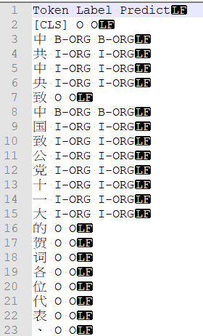
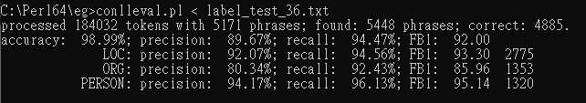
Sample Code (cont.)
Code output
Testing output
Figure : Performance on MSRA NER corpus (Exact match evaluation)
Figure : Predict output

Slide 21
A Short Report (1 page)
Report content:
Your source code and the script(s) (if any).
Describing the key concepts of data pre-processing Method: your algorithm details, including preprocessing model, the code, model training and hyperparameter tuning.
Template for report submission: ACL conference format
The report can be written in Chinese or English.
Note: Please zip all these items into a zip file and then upload to ee-class before the midnight of 5/15/2022.

Slide 22
A Short Report
Report content:
Introduction: introduce your algorithm in brief
Related work: the application of schema matching and existing matching methods
Method: your algorithm details, including preprocessing
Result: give some example of your program output
Conclusion
Reference: the paper you reference or the tool you use.

Slide 23
Grading Policy
Program 70%
prediction accuracy
Report 30%
Format
Article Structure
Rich in content

Slide 24
Thank you for listening.
Notes:
Thank you for listening

